Slide 1
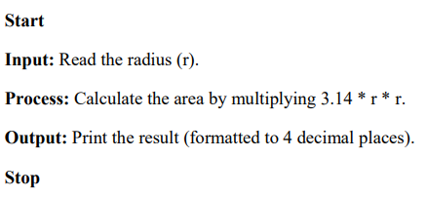
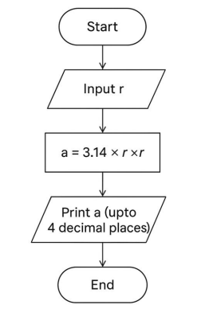
NIRMAYEE S. KADAM PRN:25070521134 SEC-C1
EX 1.1.1- AREA OF CIRCLE
ALGORITHM
FLOWCHART

Slide 2
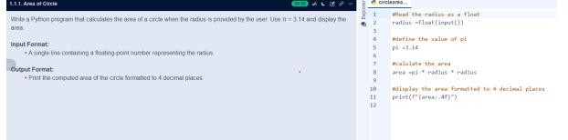
NIRMAYEE S. KADAM PRN:25070521134 SEC-C1
CODE:

